Slide 1


Angular
Aruna S
Department of
Computer Science and Engineering

Slide 2

angular
Introduction
S. Aruna
Department of Computer Science and Engineering

Slide 3
Angular
Introduction
Traditional Web Applications
Single Page Applications
What Is Better for Your Project: SPA or MPA?
Versions
Drawbacks of Angular JS and Rise of Angular
What is Angular?
Difference between Angular JS and Angular
Why is Angular So popular?
Major releases comparison

Slide 4
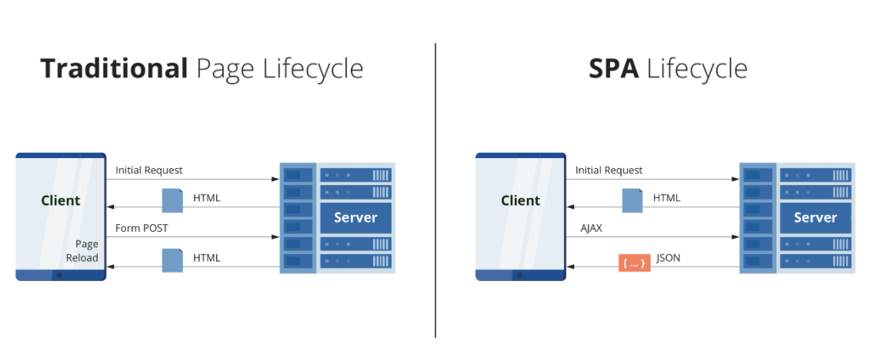
MVC in Angular
Traditional Web Applications vs SPA’s

Slide 5
MVC in Angular
Traditional Web Applications vs SPA’s
Multi-page applications are large, sometimes can be even considered cumbersome due to the number of different pages and layers of them.
Examples of MPAs on most of e-commerce websites such as Amazon and eLearning web apps like Udemy.
The technology stack, which is commonly used to write multi-page applications includes HTML, CSS, JavaScript, jQuery, and sometimes AJAX.
Pros:
Improved Search Engine Optimization (SEO)
Easier to Scale
Insightful Data Analytics
Cons:
Multi-Page App Development Is More Difficult and Expensive
Lower Performance Indicators
Expensive Maintenance

Slide 6
Angular
Single Page Applications
SPAs are much more lightweight compared to alternative app types. They don’t require any content reloads, don’t make users wait for too long to access a web page, as well as have all the data loaded automatically. It’s easier to create excellent responsive UI/UX design.
Many world-renowned companies created a single-page application, for example:
Gmail
Twitter
Facebook
Google Maps
Airbnb
Pinterest
When choosing single-page app development, software engineers generally employ the following tech stack: HTML5, Angular, React, Vue.js, Ember.js, AJAX.

Slide 7
Angular
Single Page Applications
Pros:
Faster Page Load Time
Easier and Faster to Develop
Ability to Work Offline
Enhanced User Experience
The Base for Mobile Applications
Cons:
Worse SEO
Security Issues

Slide 8
Angular
What Is Better for Your Project: SPA or MPA?
Do you want to place a lot of information on your platform?
How many features and pages do you need to add?
If you are going to build a complicated project like Amazon, eBay, or Lynda with rich functionality, release a multi-page solution.
In most cases, launching an MPA is the right choice for large companies and corporations.
If you going to build a dynamic product with little data, a SPA is a perfect option. It will give you a great bonus providing a base to write a mobile application.
SPAs are especially suited to social networks and software as a service (SaaS) platforms.
When your top priority is SEO, develop an MPA with multiple pages.

Slide 9
Angular
Versions
Angular is a blanket term that is used for all the versions which came after AngularJS (Angular 1), i.e., Angular 2,4, 5 , 6,7,8,9,10. It has the latest and most refined framework till date to design a web application that is dynamic and responsive.
During the last five years, AngularJS has evolved drastically.
It was first introduced in 2009 and it enables two-way data binding.
Utilizing HTML as a template language, it creates an environment that is quick to develop and more easily readable.
Angular lets developers to create more reusable codes. Thus, developers have to do less of coding, which saves time and helps to increase efficiency greatly.

Slide 10
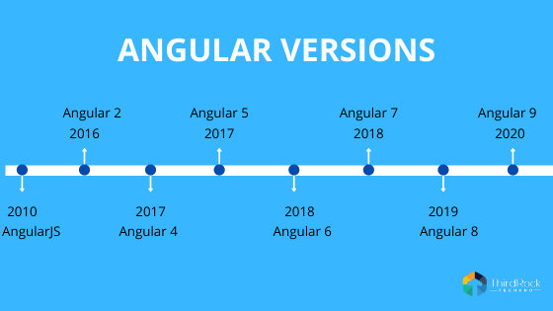
Angular
Versions

Slide 11
Angular
Drawbacks of Angular JS and Rise of Angular
AngularJS is not dead; it’s deprecated.
Google is only supporting AngularJS v1.7 until 2022.
Google did have valid reason rebuild the framework from scratch and Angular is not the only framework out there that was completely rewritten.
Vue is currently being completely rewritten in TypeScript.
React also has breaking changes in their updates.
AngularJS did not scale and was resource heavy are the reasons why it was rewritten.

Slide 12
Angular
Difference between Angular JS and Angular
Programming Language - Angular 1 used JavaScript to build the application. Angular 2 uses TypeScript which is a superset of JavaScript and helps in building more structures and robust code.
Architecture - While AngularJS is based on MVC (model-view-controller) design, Angular utilizes services/controller.
Syntax - In AngularJS you have to remember the right ngdirective to bind an image/property or an event.However, Angular (2 & 4) focus on “()” for event binding and “[]” for property binding.

Slide 13
Angular
Difference between Angular JS and Angular
Mobile Support - AngularJS was introduced without any inbuilt support for mobile application development. However, Angular offers support for building native mobile applications, which is something similar to what React Native offers.
Performance - In specific, AngularJS is for designers. It does not offer much for the developers to play with. However, Angular has many components to support a developer’s requirement, hence it can improve the overall performance of the application, especially in speed and dependency injection.

Slide 14
Angular
Why Angular is so popular?
It is easy to use
Provides MVC Architecture
It is compatible for both desktops and mobile applications
Provides filters to filter out different data types
Two way data binding
Availability of different modules
Very good testing abilities
It is flexible and extensible

Slide 15
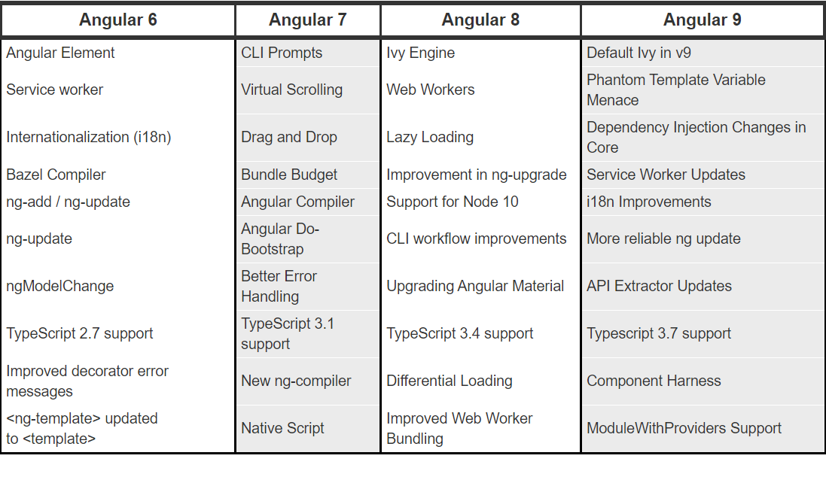
Angular
Major releases comparison

Slide 16
THANK YOU
Aruna S
Department of
Computer Science and Engineering
arunas@pes.edu

